Slide 1

Drawing System Sequence Diagrams
Chapter 10
Applying UML and Patterns
Craig Larman
Presented by Anuradha Dharani

Slide 2
Objectives
Identify System Events.
Create System Sequence diagrams for the events.

Slide 3
Iteration 1
First real development iteration.
The requirement work done during inception phase was to decide if the project was worth more serious investigation.
Before starting iteration 1 design work, further investigation of the problem domain is useful such as clarification of the input and output system events, related to the system.

Slide 4
SSD versus Sequence Diagram
A System Sequence Diagram is an artifact that illustrates input and output events related to the system under discussion.
System Sequence Diagrams are typically associated with use-case realization in the logical view of system development.
Sequence Diagrams (Not System Sequence Diagrams) display object interactions arranged in time sequence.

Slide 5
Sequence Diagrams
Sequence Diagrams depict the objects and classes involved in the scenario and the sequence of messages exchanged between the objects needed to carry out the functionality of the system.
Sequence diagrams can be used to drive out testable user interface requirements.

Slide 6
SSD—System Behavior
System behaves as “Black Box”.
Interior objects are not shown, as they would be on a Sequence Diagram.
:System

Slide 7
System Sequence Diagrams
Use cases describe-
How actors interact with system.
Typical course of events that external actors generate and
The order of the events.

Slide 8
System Sequence
Diagrams(2)
For a particular scenario of use-case an SSD shows-
The external actors that interact directly with the system.
The System (as a black box).
The system events that the actors generate.

Slide 9
System Sequence
Diagrams(3)
The operations of the system in response to the events generated.
System Sequence Diagrams depict the temporal order of the events.
System Sequence Diagrams should be done for the main success scenario of the use-case, and frequent and alternative scenarios.

Slide 10
Notation
Object: Objects are instances of classes. Object is represented as a rectangle which contains the name of the object underlined.
Because the system is instantiated, it is shown as an object.
:Object1

Slide 11
Notation (2)
Actor: An Actor is modeled using the ubiquitous symbol, the stick figure.
actor1

Slide 12
Notation (3)
Lifeline: The LifeLine identifies the existence of the object over time. The notation for a Lifeline is a vertical dotted line extending from an object.

Slide 13
Notation (4)
Message: Messages, modeled as horizontal arrows between Activations, indicate the communications between objects.
messageName(argument)

Slide 14
Example of an SSD
Following example shows the success scenario of the Process Sale use case.
Events generated by cashier (actor)-
makeNewSale
      enterItem
      endSale and
      makePayment.

Slide 15
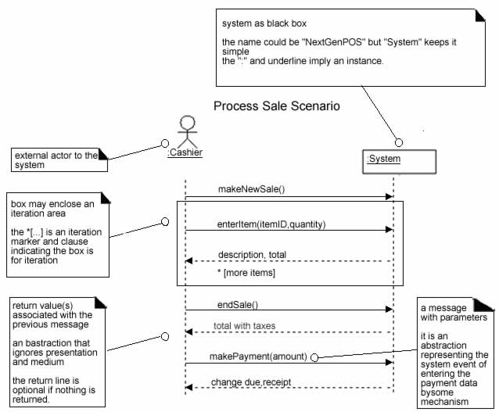
SSD for Process Sale scenario

Slide 16
System Sequence Diagrams and Use Cases
System Sequence Diagram is generated from inspection of a use case.
Constructing a systems sequence diagram from a use case-
1.Draw a line representing the system as a black box.
2.Identify each actor that directly operates on the system. Draw a line for each such actor.

Slide 17
System Sequence Diagrams and Use Cases
3.From the use case, typical course of events text, identify the system (external) events that each actor generates. They will correspond to an entry in the right hand side of the typical use case. Illustrate them on the diagram.
4.Optionally, include the use case text to the left of the diagram.

Slide 18
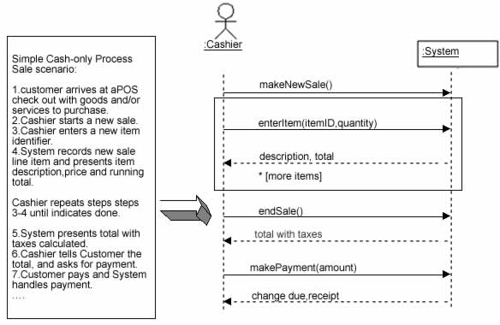
SSDs are derived from use cases.

Slide 19
System Events and System Boundary
To identify the system events, system boundary is critical.
For the purpose of software development, the system boundary is chosen to be the software system itself.

Slide 20
System Events and System Boundary(2)
Identifying the System events-
Determine the actors that directly interact with the system.
In the process Sale example, the customer does not directly interact with the POS system. Cashier interacts with the system directly. Therefore cashier is the generator of the system events.

Slide 21
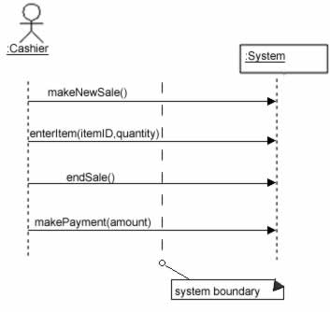
Defining system boundary.

Slide 22
Naming System Events and Operations
System event
External input event generated by an actor.
Initiates a responding operation by system.
System operation
Operation invoked in response to system event.

Slide 23
Naming System Events and Operations(2)
System events and their associated system operations should be expressed at the level of intent rather than in terms of the physical input medium or widget.
In order to improve the clarity, it is appropriate to start the name of the system event with a verb (for example- add….,enter….,end….,make…. etc.,). It also emphasizes the command origination of these events.

Slide 24
Naming System Events and Operations(3)
For example “enterItem” is better than “scan” as it captures the intent of operation rather than what interface is used to capture the system event (design choice).

Slide 25
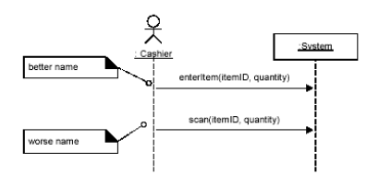
Choose event and operation names at an abstract level

Slide 26
Showing Use Case Text
It is desirable to show at least fragments of use case text for the scenario.
The text provides the details and context, while the diagram visually summarizes the interaction.

Slide 27
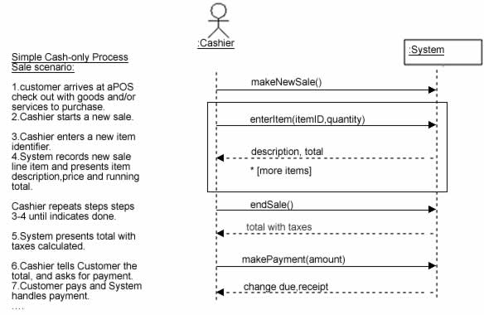
SSD with use case text

Slide 28
SSD and the Glossary
Since the terms used in SSDs are terse, they may need proper explanation. If these terms are not explained in use cases, glossary could be used.
A glossary is less formal, it is easier to maintain and more intuitive to discuss with external parties such as users and customers.
However, glossary data should be meaningful, otherwise it will be an unnecessary work.

Slide 29
System Sequence Diagrams Within the Unified Process
System Sequence Diagrams are a visualization of the interactions implied in the use cases.
System Sequence Diagrams were not explicitly mentioned in the original UP description.
Phases
1.Inception: System Sequence Diagrams are not usually motivated in inception.

Slide 30
System Sequence Diagrams Within the Unified Process
Elaboration: It is useful to create System Sequence Diagrams during elaboration in order to -
Identify the system events and major operations.
To write system operation contracts (Contracts describe detailed system behavior) and
To support estimation.

Slide 31
Conclusion
System Sequence Diagrams provide a way for us to visually step through invocation of the operations defined by Use-Cases.
It is not necessary to create SSDs for all scenarios of all use-cases,at least not at the same time.

Slide 32
References
An Introduction to Object-Oriented Analysis and Design and the Unified Process - Craig Larman
Visual Modeling with Rational Rose 2002 and UML-Terry Quatrani
http://www.rational.com/media/uml/intro_rdn.pdf
http://www.modelingstyle.info/dequenceDiagram.html

